Slide 1
APP TRADER
10 apps to weather the COVID-19 Pandemic

Slide 2
APP TRADER
APPS for a Worldwide
Pandemic

Slide 3
Our Criteria
Crossover Titles
Free Price Tag
Rating of 4.5+ stars

Slide 4
Crossover Titles
$4,000 per month
Over $500,000 net lifetime profit per app
Low monthly advertisement fee

Slide 5
Free
Low upfront cost to purchase app
Investment returned in 5 months
No threshold to buys
Huge download base

Slide 6
Rating
4.5 stars and above
More stars = longer lifespan
Lifespan = more money for less

Slide 7

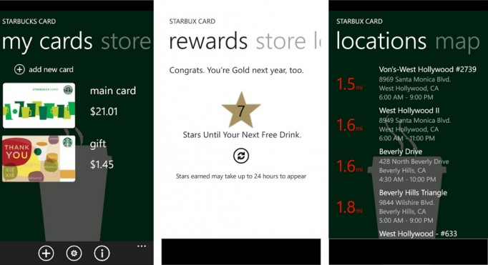
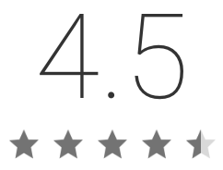
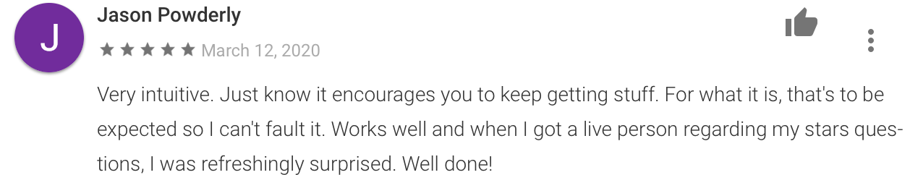
Starbucks
Always keep caffeinated.

Slide 8

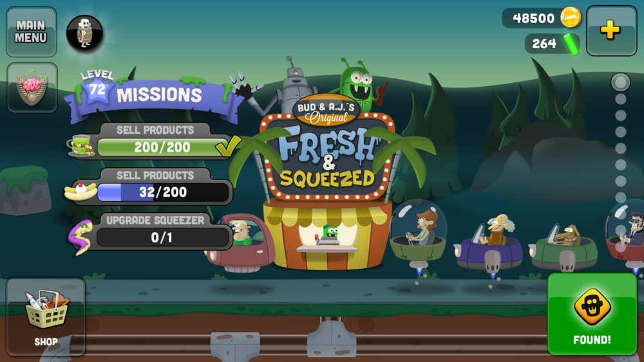
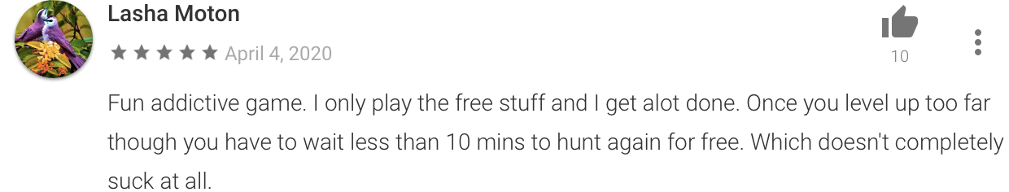
Zombie Catchers

Slide 9


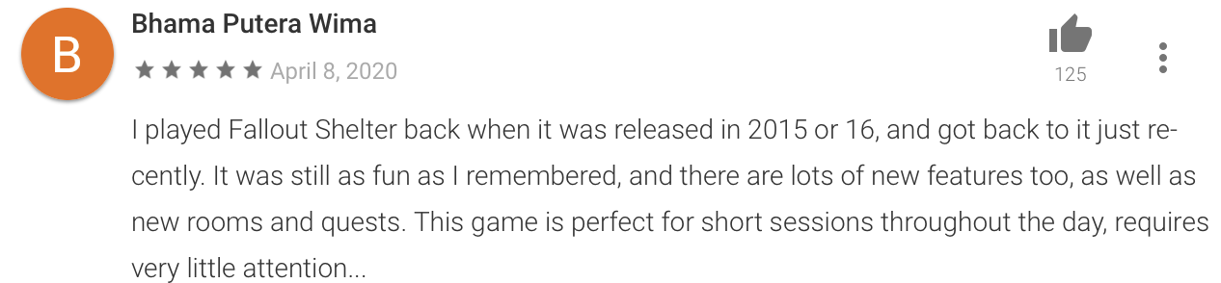
Fallout Shelter

